Slide 1
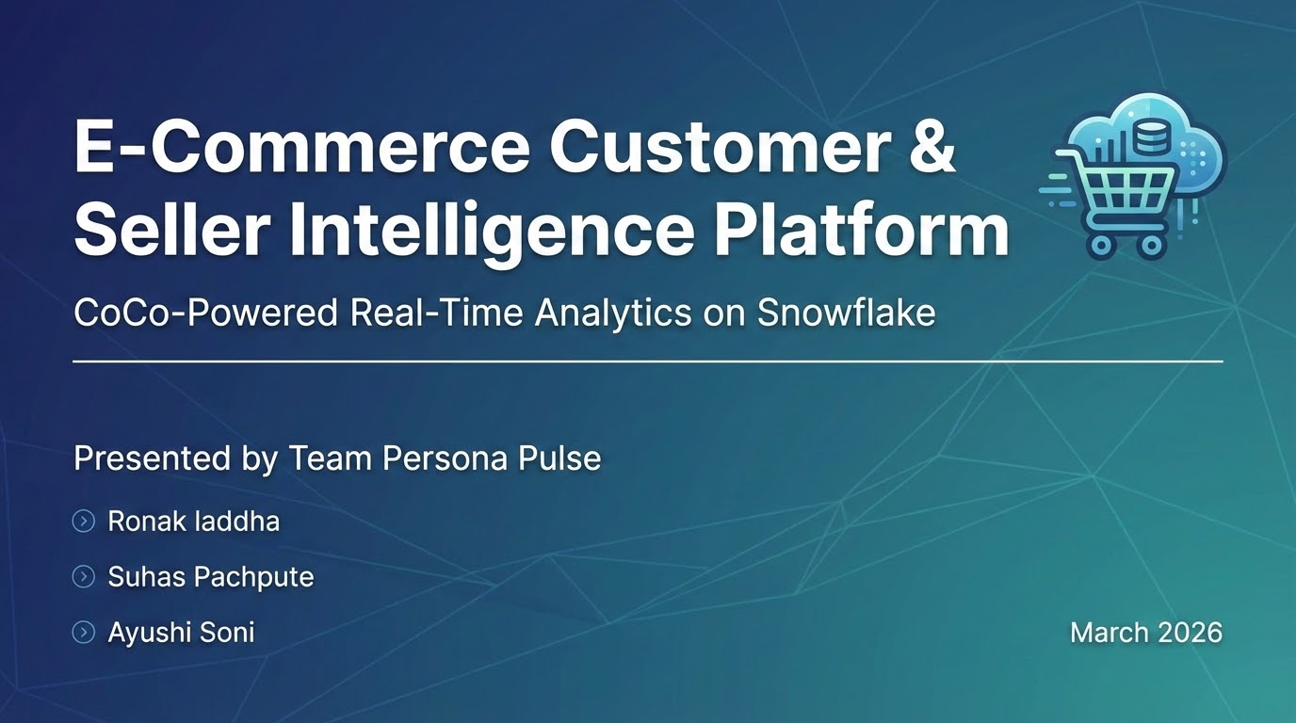
E-Commerce Customer & Seller Intelligence Platform
CoCo-Powered Real-Time Analytics on Snowflake
Presented by Team Persona Pulse
>Ronak laddha
>Suhas Pachpute
>Ayushi Soni
March 2026

Slide 2
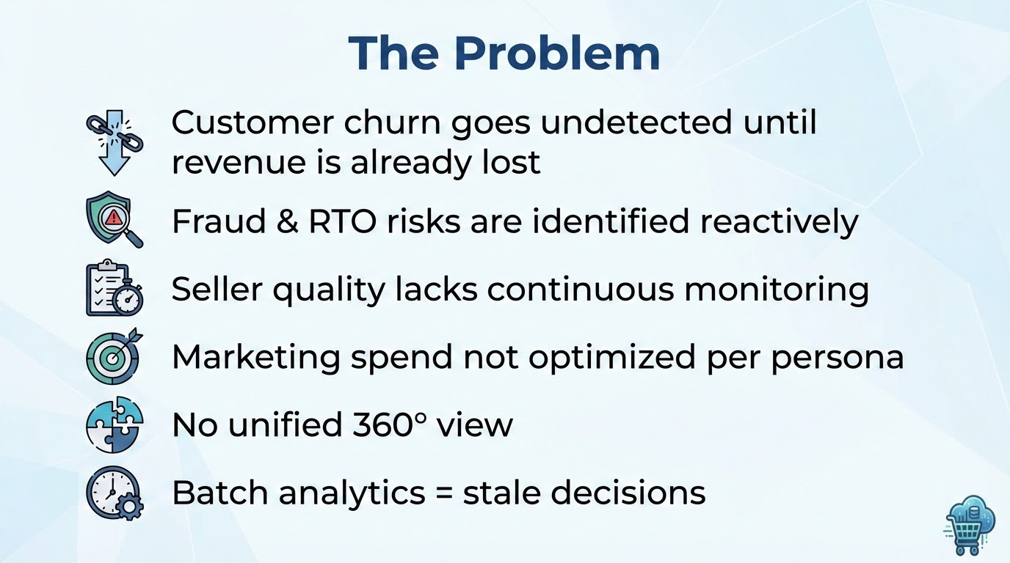
The Problem
Customer churn goes undetected until revenue is already lost
Fraud & RTO risks are not identified reactively
Seller quality lacks continuous monitoring
Marketing spend not optimized per persona
No unified 360° view
Batch analytics = stale decisions

Slide 3
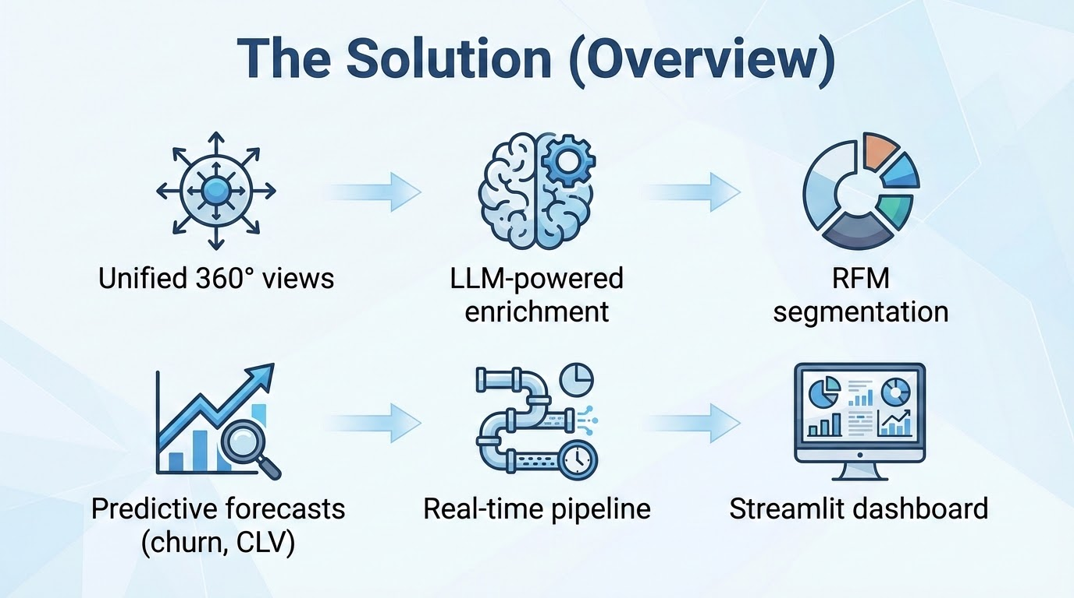
The Solution (Overview)
Unified 360° views
LLM-powered enrichment
RFM segmentation
Predictive forecasts (churn, CLV)
Real-time pipeline
Streamlit dashboard

Slide 4
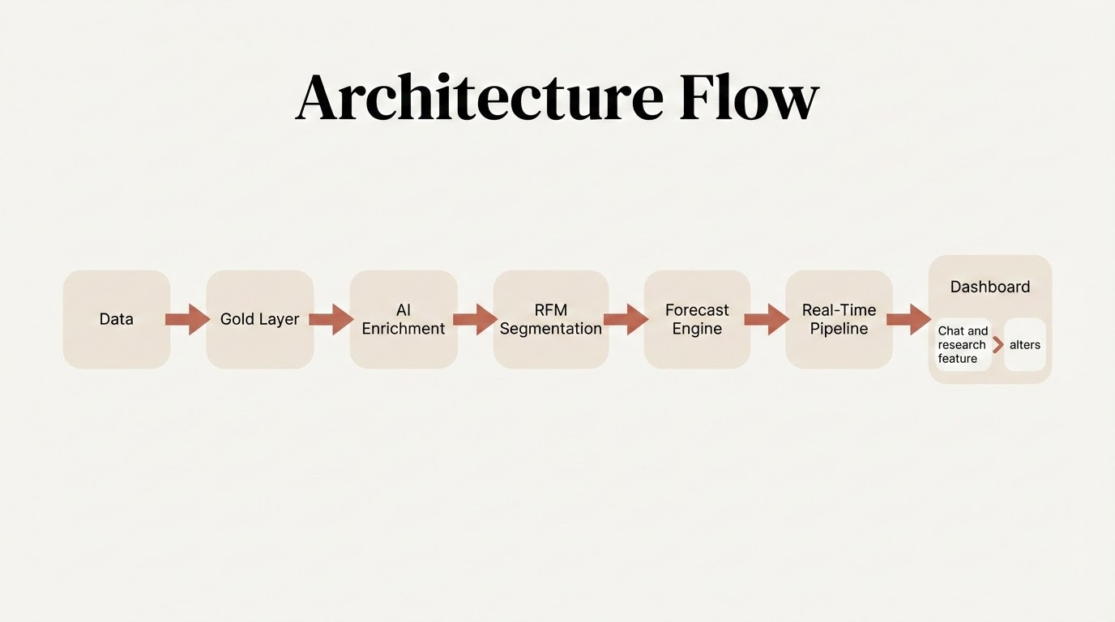
Architecture Flow
Data → Gold Layer → AI Enrichment → RFM Segmentation → Forecast Engine → Real-Time Pipeline → Dashboard>Chat and research feature > alters

Slide 5
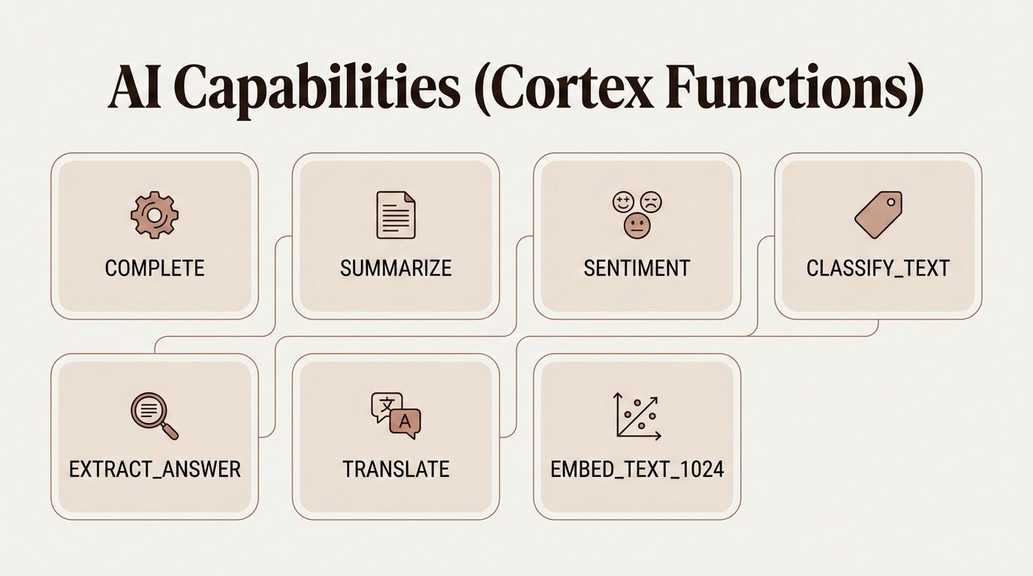
AI Capabilities (Cortex Functions)
COMPLETE, SUMMARIZE, SENTIMENT, CLASSIFY_TEXT,
EXTRACT_ANSWER, TRANSLATE, EMBED_TEXT_1024

Slide 6
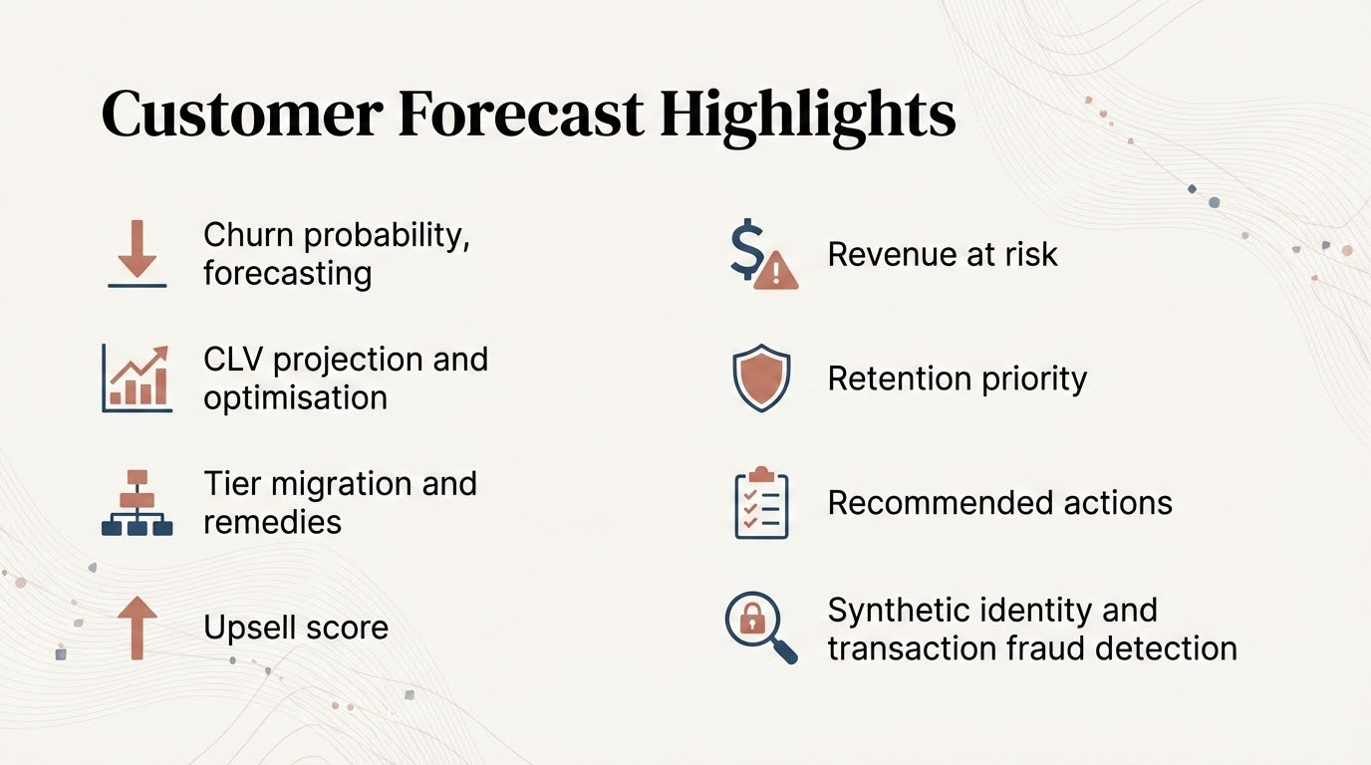
Customer Forecast Highlights
Churn probability, forecasting
CLV projection and optimisation
Tier migration and remedies
Upsell score
Revenue at risk
Retention priority
Recommended actions
Synthetic identity and transaction fraud detection

Slide 7
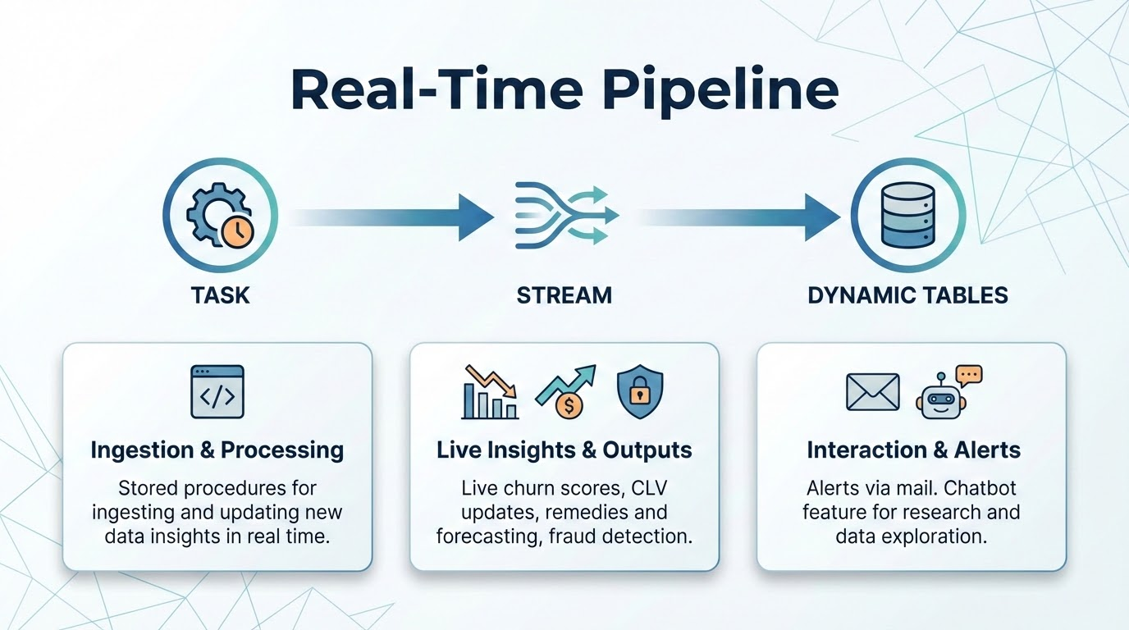
Real-Time Pipeline
Task → Stream → Dynamic Tables
stored procedures for ingesting and updating new data insights in real time
Live churn scores, CLV updates, remedies and forecasting, fraud detection
Alerts via mail
Chatbot feature for research and data exploration

Slide 8
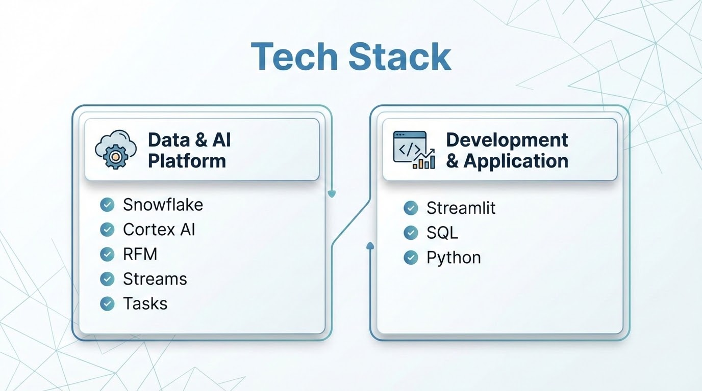
Streamlit Dashboard
Tech Stack
Alerts, Table Browser, Customer Insights, Seller Insights,
Combined Analytics, Customer Forecast, Seller Forecast
Snowflake, Cortex AI, RFM, Streams, Tasks,
Streamlit, SQL, Python

Slide 9
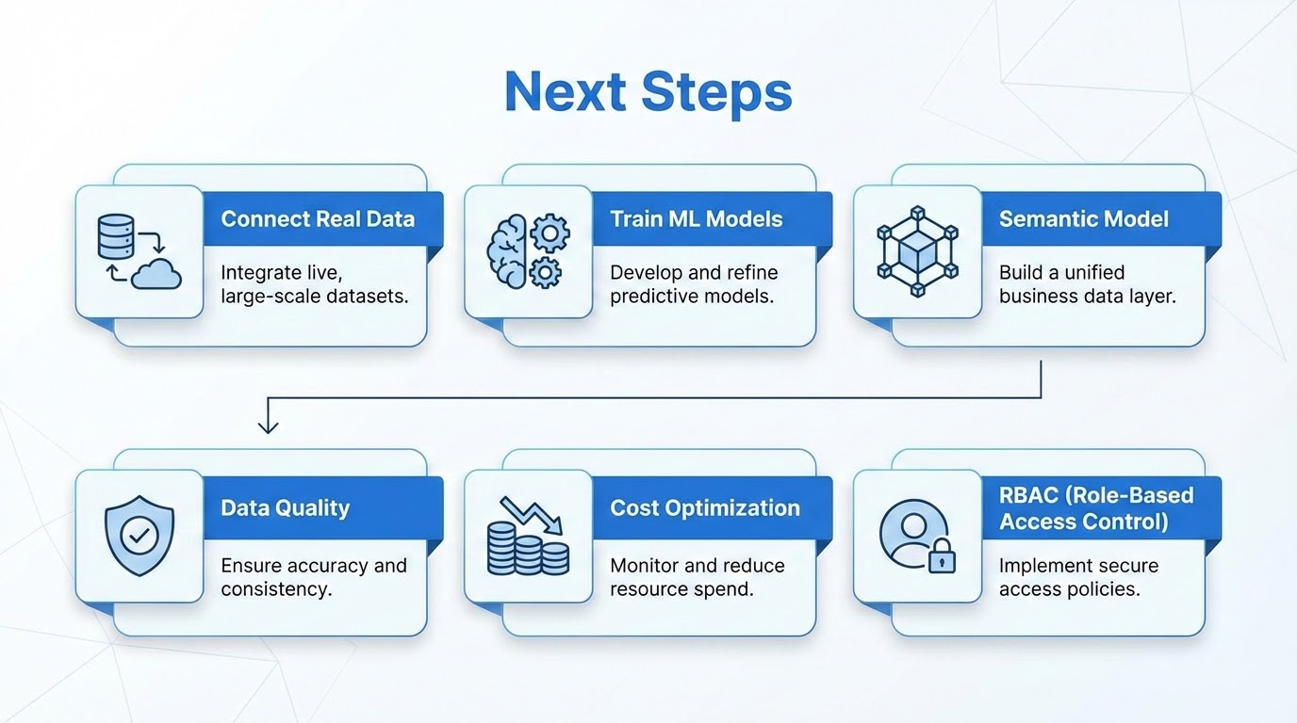
Next Steps
Connect real data
Train ML models
Semantic model
Data quality
Cost optimization
RBAC

Slide 10
